Slide 1
Heritability Estimation of Dichotomous phenotypes Using a Liability Threshold Model on Ascertained Family-based Samples
Statistical Genetics and Network Science Meeting
Wonji Kim
Jan 23, 2019

Slide 2

Heritability
Introduction
Variation
in height
Height
Notes:
Variation of traits due to genetic factor

Slide 3

Heritability
Introduction
Height
Age
Notes:
Variation of traits due to genetic factor

Slide 4

Heritability
Introduction
Notes:
Variation of traits due to genetic factor

Slide 5
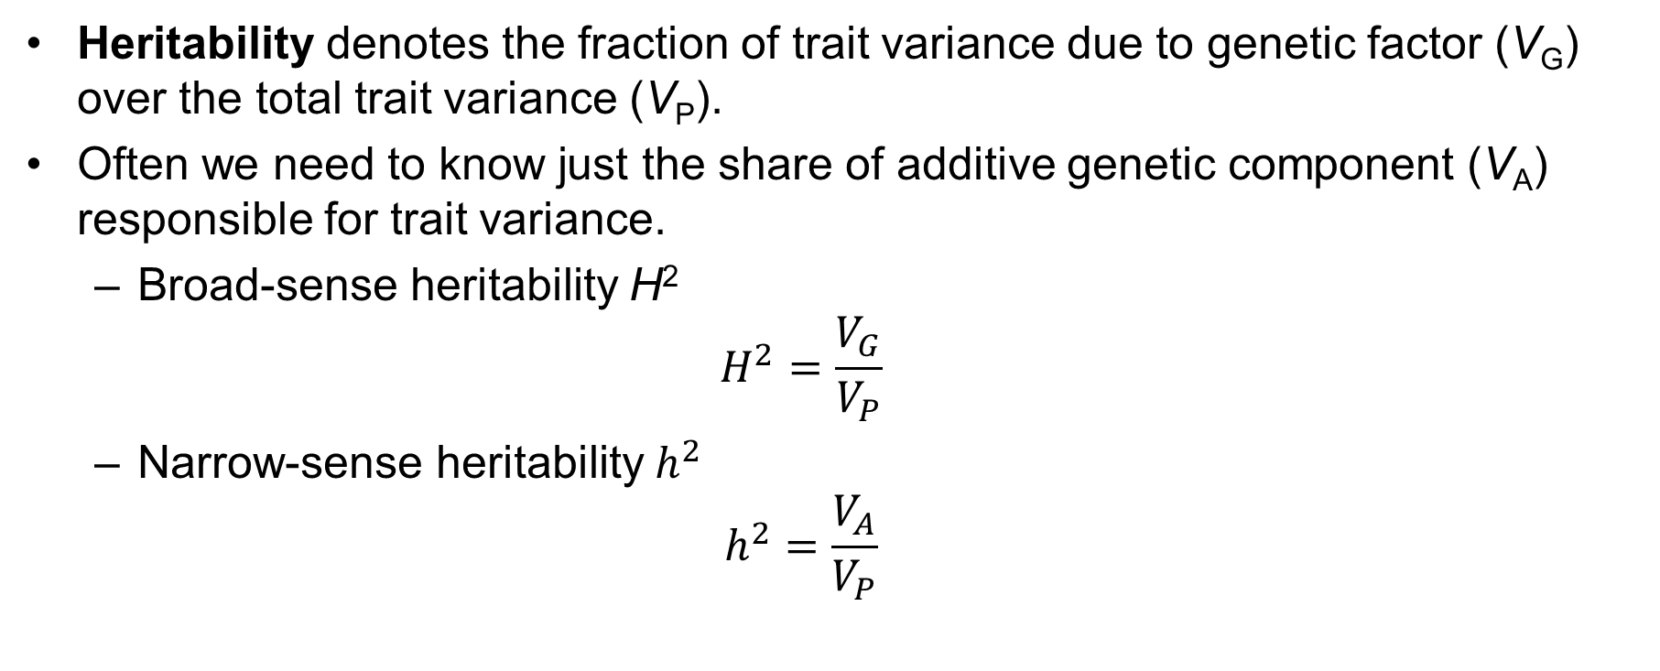
Heritability
Introduction
Heritability denotes the fraction of trait variance due to genetic factor (V_{G}) over the total trait variance (V_{P}).
Often we need to know just the share of additive genetic component (V_{A}) responsible for trait variance.
Broad-sense heritability H²
$$H^{2}=\frac{V_{G}}{V_{P}}$$
Narrow-sense heritability $h^{2}$
$$h^{2}=\frac{V_{A}}{V_{P}}$$
Notes:
Meaning of heritability& its use

Slide 6
Recent Improvements
Introduction
Estimation of heritability on binary traits
Method | Contents
Linear Mixed Model (LMM) | GCTA, ...
Generalized Linear Mixed Model (GLMM) | BVC (logit), ...
Bayesian approach | Beta-binomial, ...
Liability Threshold Model (LTM) | SOLAR

Slide 7
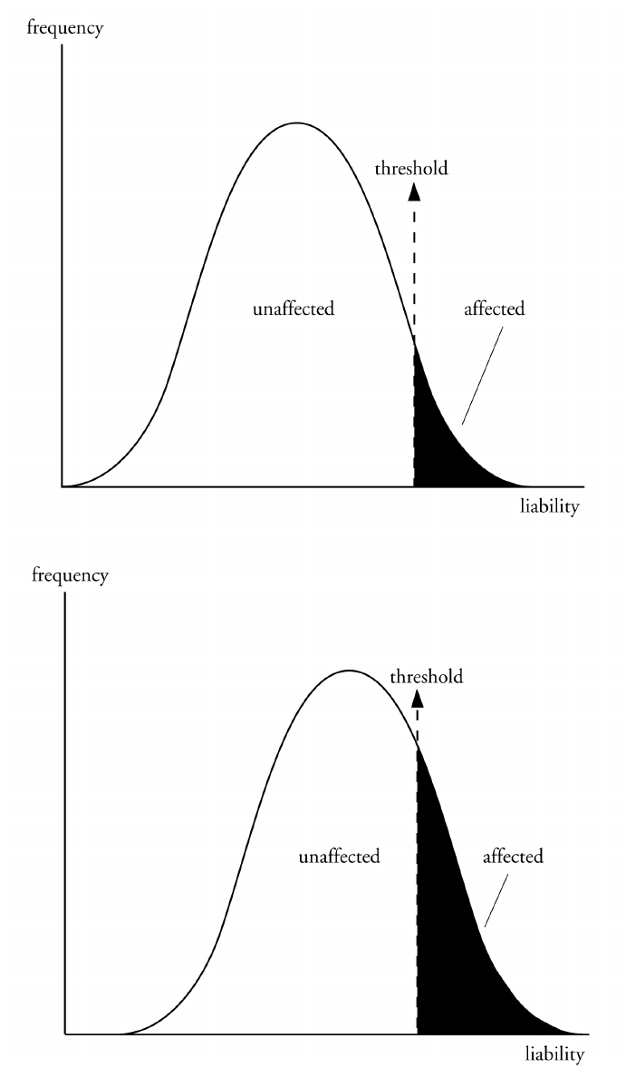
Liability Threshold Model (LTM)
Introduction
Liability is a term used to describe all the genetic and environmental factors that contribute to the development of a multifactorial disorder.
A lot of multifactorial traits display continuous variation such as height and intelligence.
However, some multifactorial disorders such as diabetes mellitus and cancer display discontinuous variation with individuals either being affected or not.
The threshold model allows this phenomenon to be explained.

Slide 8
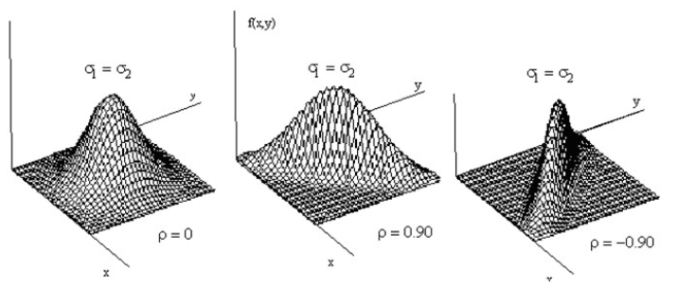
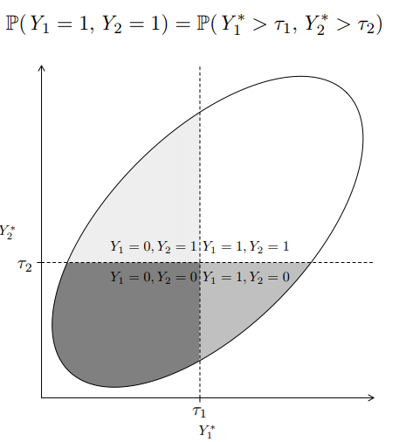
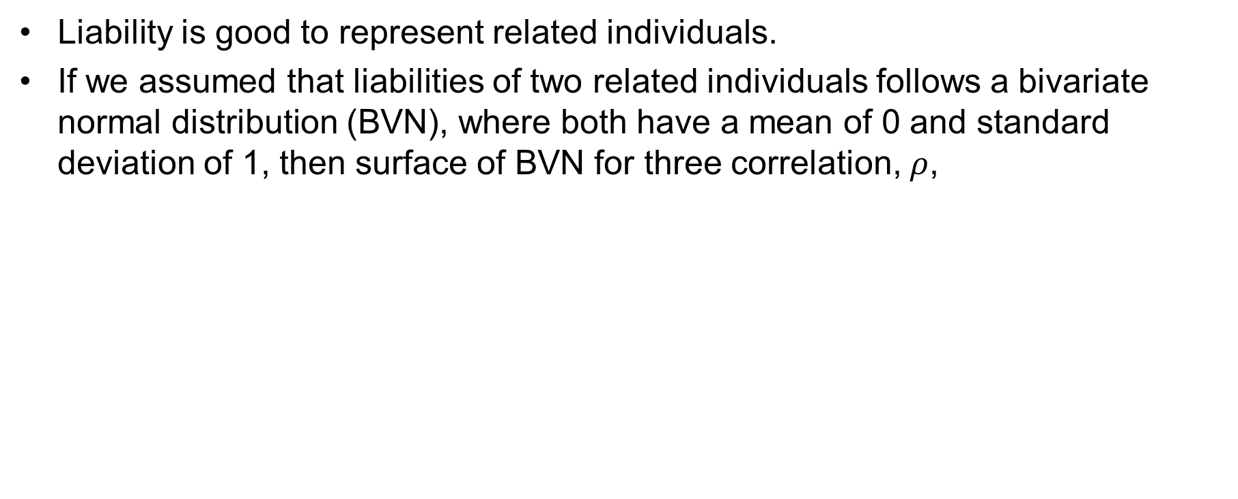
Liability Threshold Model (LTM)
Introduction
Liability is good to represent related individuals.
If we assumed that liabilities of two related individuals follows a bivariate normal distribution (BVN), where both have a mean of 0 and standard deviation of 1, then surface of BVN for three correlation, $ρ$,

Slide 9
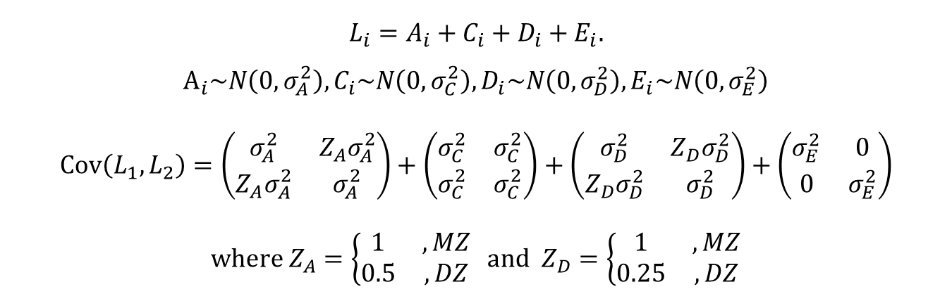
Heritability in Liability Threshold Model
Introduction
Polygenic model for bivariate liabilities of twin (ACE model)
Neale, M. C. C. L., & Cardon, L. R. (2013). Methodology for genetic studies of twins and families (Vol. 67). Springer Science & Business Media

Slide 10
Ascertainment bias
Introduction

Slide 11
Purpose and Novelty of This Study
2. An overview of liability threshold model
Review of Liability Threshold Model
Review of heritability
Purpose and novelty of this study
In chapter 3, the proposed method could
quantify family history of disease for general family structure
select informative subjects based on the disease status of their relatives
improve statistical power of genetic association studies
be implemented with R language
In chapter 4, the proposed method could
estimate the heritability and genetic/environmental effect simultaneously
provide robust estimator to misspecification of prevalence
perform statistical testing using conditional expected score test

Slide 12
Heritability Estimation and Genetic Association Study in Family-based Design for the Disease on the Binary Trait using Liability Threshold Model
Notations and the disease model
Estimation of the parameters using the EM algorithm
Conditional expected score test
Simulation study
Application to GWAS of LAM
Application to heritability estimation of CRC
Discussion

Slide 13
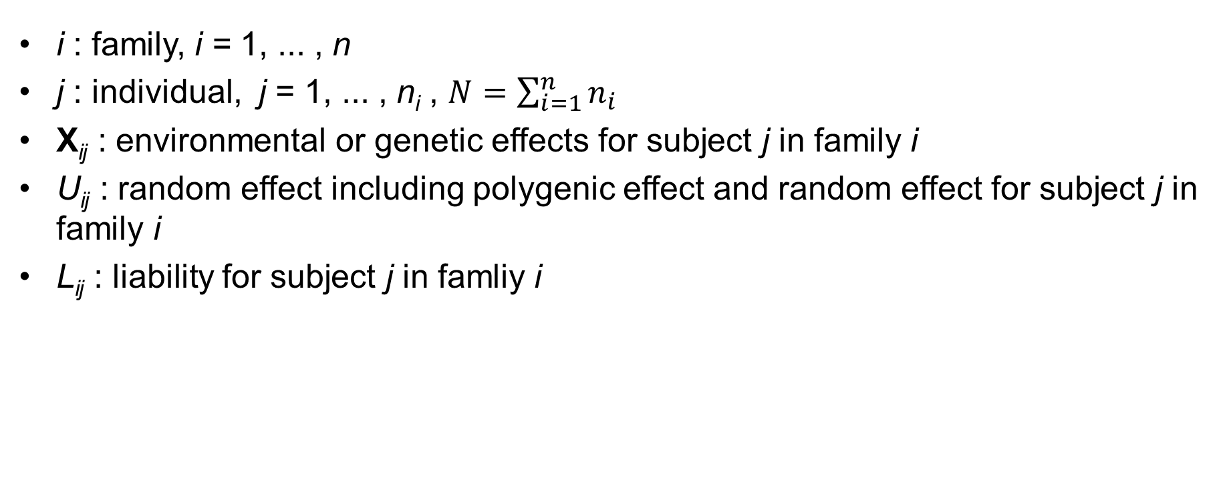
Notations
Method
Notations and the disease model
Estimation of the parameters using the EM algorithm
Conditional expected score test
i : family, i = 1, ... , n
j : individual, j = 1, ... , n_{i} , $N=\sum_{i=1}^{n}{n_{i}}$
X_{ij} : environmental or genetic effects for subject j in family i
U_{ij} : random effect including polygenic effect and random effect for subject j in family i
L_{ij} : liability for subject j in famliy i

Slide 14
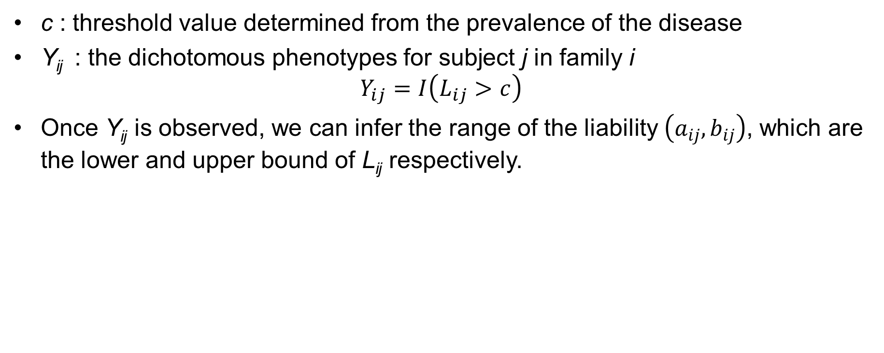
Notations
Method
Notations and the disease model
Estimation of the parameters using the EM algorithm
Conditional expected score test
c : threshold value determined from the prevalence of the disease
Y_{ij} : the dichotomous phenotypes for subject j in family i $Y_{ij}=I\left(L_{ij}>c\right)$
Once Y_{ij} is observed, we can infer the range of the liability $\left(a_{ij},b_{ij}\right)$, which are the lower and upper bound of L_{ij} respectively.

Slide 15
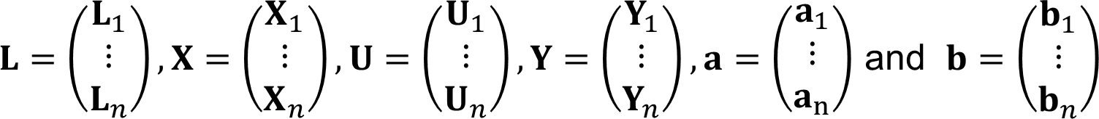
Notations
Method
Notations and the disease model
Estimation of the parameters using the EM algorithm
Conditional expected score test
Vector form

Slide 16
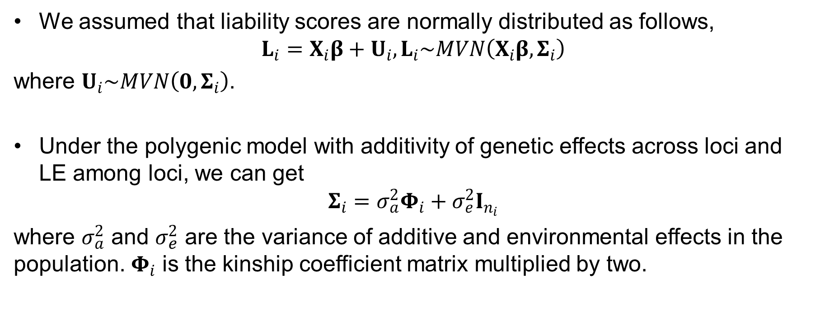
Disease Model
4. Heritability Estimation and Genetic Association Study on the Binary Trait
Notations and the disease model
Estimation of the parameters using the EM algorithm
Conditional expected score test
We assumed that liability scores are normally distributed as follows,
$$L_{i}=X­_{i}β+U_{i}, L_{i}\sim MVN\left(X­_{i}β,Σ_{i}\right)$$
where $U_{i}\sim MVN\left(0,Σ_{i}\right)$.
Under the polygenic model with additivity of genetic effects across loci and LE among loci, we can get
$$Σ_{i}=σ_{a}^{2}Φ_{i}+σ_{e}^{2}I_{n_{i}}$$
where $σ_{a}^{2}$ and $σ_{e}^{2}$ are the variance of additive and environmental effects in the population. $Φ_{i}$ is the kinship coefficient matrix multiplied by two.

Slide 17
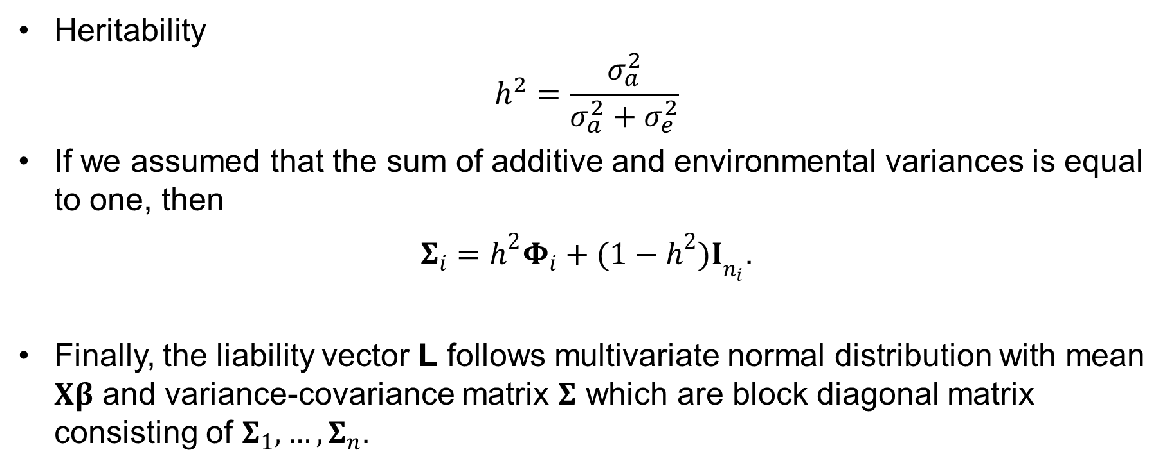
Disease Model
4. Heritability Estimation and Genetic Association Study on the Binary Trait
Notations and the disease model
Estimation of the parameters using the EM algorithm
Conditional expected score test
Heritability
$$h^{2}=\frac{σ_{a}^{2}}{σ_{a}^{2}+σ_{e}^{2}}$$
If we assumed that the sum of additive and environmental variances is equal to one, then
$Σ_{i}={h^{2}Φ}_{i}+{(1−h^{2})I}_{n_{i}}$.
Finally, the liability vector L follows multivariate normal distribution with mean $Xβ$ and variance-covariance matrix $Σ$ which are block diagonal matrix consisting of $Σ_{1},…, Σ_{n}$.

Slide 18


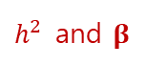
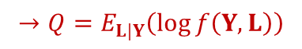
Estimation of the parameters
4. Heritability Estimation and Genetic Association Study on the Binary Trait
Notations and the disease model
Estimation of the parameters using the EM algorithm
Conditional expected score test
EM algorithm (Dempster et al., 1977) : an iterative method to find maximum likelihood estimates of parameters in statistical models, where the model depends on unobserved latent variables.
Procedure
Define complete data consisting of observed variable & unobserved (missing, latent) variable
Obtain the joint log likelihood function of observed and unobserved variables
Take conditional expectation given observed variable to the joint log likelihood function and denote it as Q
Calculate maximizer of Q with respect to the parameter of interest
Update Step 3, 4 and iterate until convergence
$$Y$$
$$L$$
$$→Q=E_{L|Y}\left(\log{f\left(Y,L\right)}\right)$$
$h^{2}$ and $β$

Slide 19
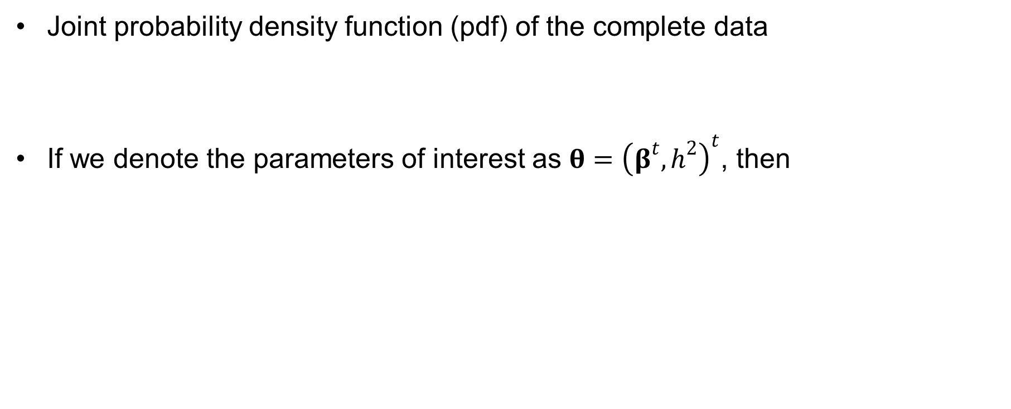
Estimation of the parameters
4. Heritability Estimation and Genetic Association Study on the Binary Trait
Notations and the disease model
Estimation of the parameters using the EM algorithm
Conditional expected score test
Joint probability density function (pdf) of the complete data
If we denote the parameters of interest as $θ={\left(β^{t},h^{2}\right)}^{t}$, then

Slide 20
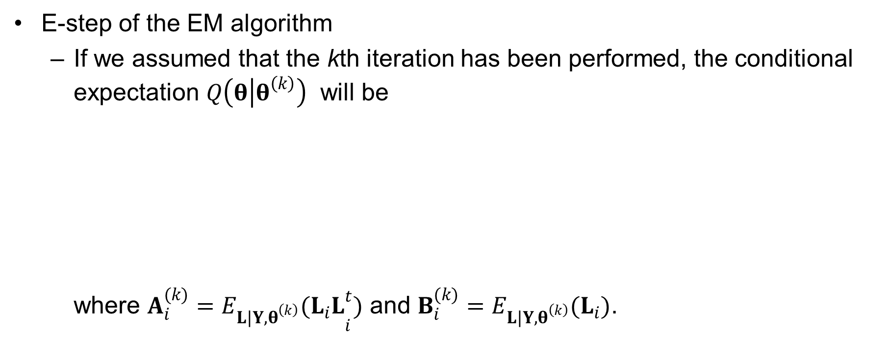
Estimation of the parameters
4. Heritability Estimation and Genetic Association Study on the Binary Trait
Notations and the disease model
Estimation of the parameters using the EM algorithm
Conditional expected score test
E-step of the EM algorithm
If we assumed that the kth iteration has been performed, the conditional expectation $Q\left(θ | θ^{\left(k\right)}\right)$ will be where $A_{i}^{(k)}={E_{L|Y,θ^{\left(k\right)}}(L_{i}L}_{i}^{t})$ and $B_{i}^{(k)}=E_{L|Y,θ^{\left(k\right)}}(L_{i})$.

Slide 21
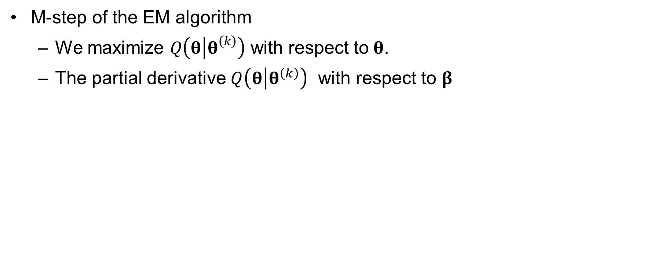
Estimation of the parameters
4. Heritability Estimation and Genetic Association Study on the Binary Trait
Notations and the disease model
Estimation of the parameters using the EM algorithm
Conditional expected score test
M-step of the EM algorithm
We maximize $Q\left(θ | θ^{\left(k\right)}\right)$ with respect to$θ$.
The partial derivative $Q\left(θ | θ^{\left(k\right)}\right)$ with respect to $β$

Slide 22
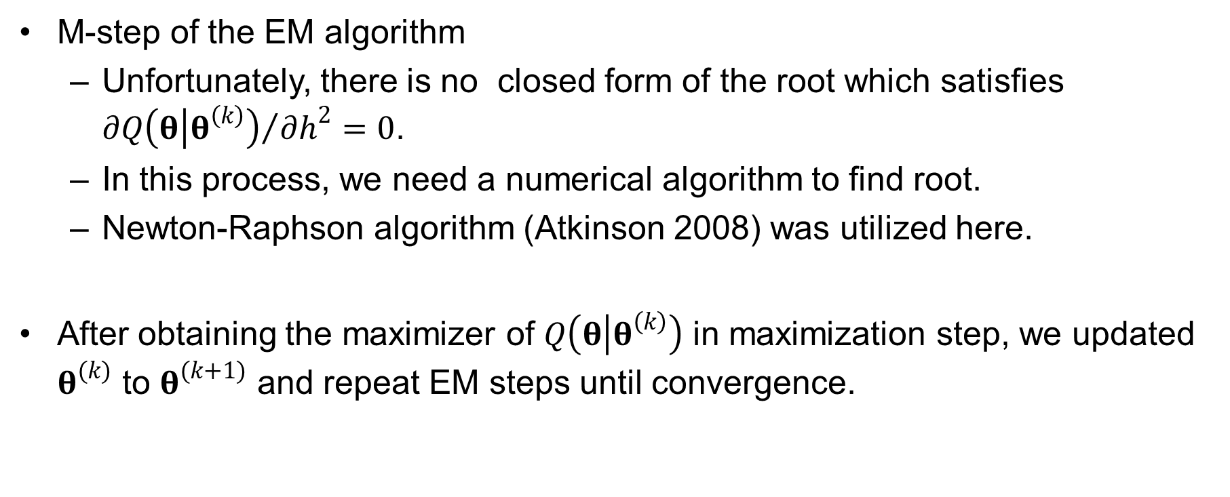
Estimation of the parameters
4. Heritability Estimation and Genetic Association Study on the Binary Trait
Notations and the disease model
Estimation of the parameters using the EM algorithm
Conditional expected score test
M-step of the EM algorithm
Unfortunately, there is no closed form of the root which satisfies ${∂Q\left(θ | θ^{\left(k\right)}\right)}/{∂h^{2}}=0$.
In this process, we need a numerical algorithm to find root.
Newton-Raphson algorithm (Atkinson 2008) was utilized here.
After obtaining the maximizer of $Q\left(θ | θ^{\left(k\right)}\right)$ in maximization step, we updated $θ^{(k)}$ to $θ^{(k+1)}$ and repeat EM steps until convergence.

Slide 23
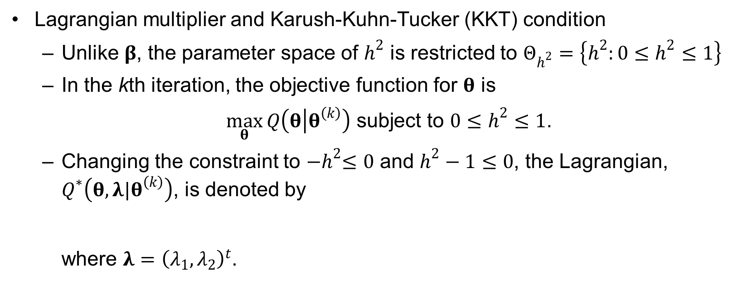
Estimation of the parameters
4. Heritability Estimation and Genetic Association Study on the Binary Trait
Notations and the disease model
Estimation of the parameters using the EM algorithm
Conditional expected score test
Lagrangian multiplier and Karush-Kuhn-Tucker (KKT) condition
Unlike $β$, the parameter space of $h^{2}$ is restricted to $Θ_{h^{2}}=\left\{h^{2}:0≤h^{2}≤1\right\}$
In the kth iteration, the objective function for $θ$ is
$\max_{θ}{Q\left(θ | θ^{\left(k\right)}\right)}$ subject to $0≤h^{2}≤1$.
Changing the constraint to ${−h}^{2}≤0$ and $h^{2}−1≤0$, the Lagrangian, $Q^{∗}\left(θ,λ|θ^{\left(k\right)}\right)$, is denoted by where $λ={\left(λ_{1},λ_{2}\right)}^{t}$.

Slide 24
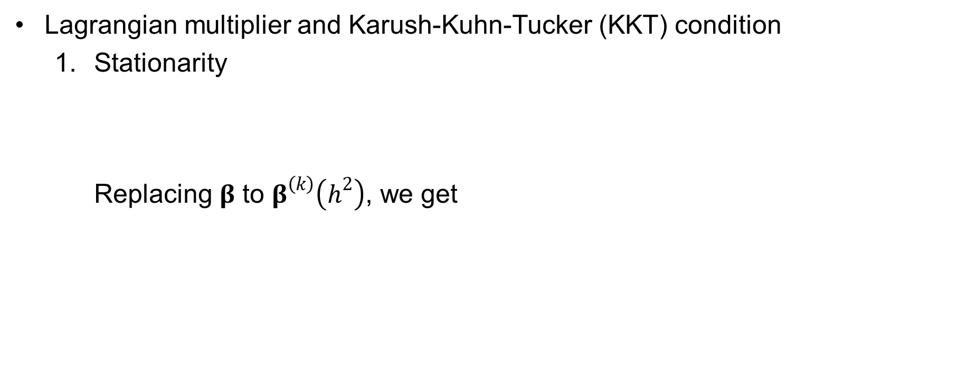
Estimation of the parameters
4. Heritability Estimation and Genetic Association Study on the Binary Trait
Notations and the disease model
Estimation of the parameters using the EM algorithm
Conditional expected score test
Lagrangian multiplier and Karush-Kuhn-Tucker (KKT) condition
Stationarity Replacing $β$ to $β^{\left(k\right)}\left(h^{2}\right)$, we get

Slide 25
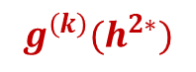
Estimation of the parameters
4. Heritability Estimation and Genetic Association Study on the Binary Trait
Notations and the disease model
Estimation of the parameters using the EM algorithm
Conditional expected score test
Lagrangian multiplier and Karush-Kuhn-Tucker (KKT) condition
Stationarity
and it is equivalent to
$$g^{\left(k\right)}(h^{2∗})$$

Slide 26
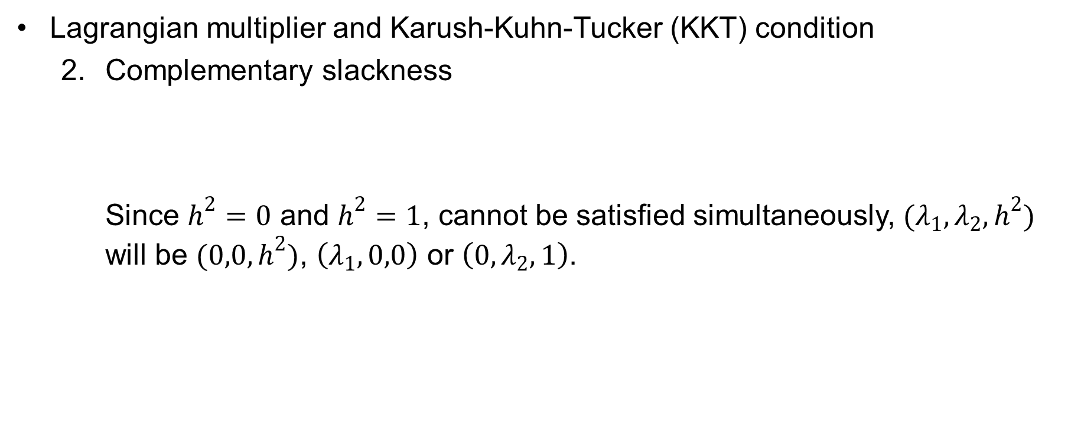
Estimation of the parameters
4. Heritability Estimation and Genetic Association Study on the Binary Trait
Notations and the disease model
Estimation of the parameters using the EM algorithm
Conditional expected score test
Lagrangian multiplier and Karush-Kuhn-Tucker (KKT) condition
Complementary slackness Since $h^{2}=0$ and $h^{2}=1$, cannot be satisfied simultaneously, $(λ_{1},λ_{2},h^{2})$ will be $(0,0,h^{2})$, $\left(λ_{1},0,0\right)$ or $\left(0,λ_{2},1\right)$.

Slide 27
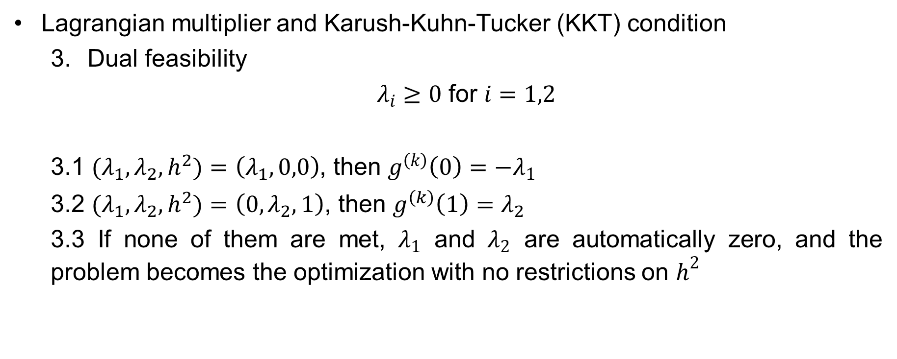
Estimation of the parameters
4. Heritability Estimation and Genetic Association Study on the Binary Trait
Notations and the disease model
Estimation of the parameters using the EM algorithm
Conditional expected score test
Lagrangian multiplier and Karush-Kuhn-Tucker (KKT) condition
Dual feasibility
$λ_{i}≥0$ for $i=1,2$
3.1 $(λ_{1},λ_{2},h^{2})$ $=\left(λ_{1},0,0\right)$, then $g^{\left(k\right)}\left(0\right)={−λ}_{1}$
3.2 $(λ_{1},λ_{2},h^{2})$ $=\left(0,λ_{2},1\right)$, then $g^{\left(k\right)}\left(1\right)=λ_{2}$
3.3 If none of them are met, $λ_{1}$ and $λ_{2}$ are automatically zero, and the problem becomes the optimization with no restrictions on $h^{2}$

Slide 28
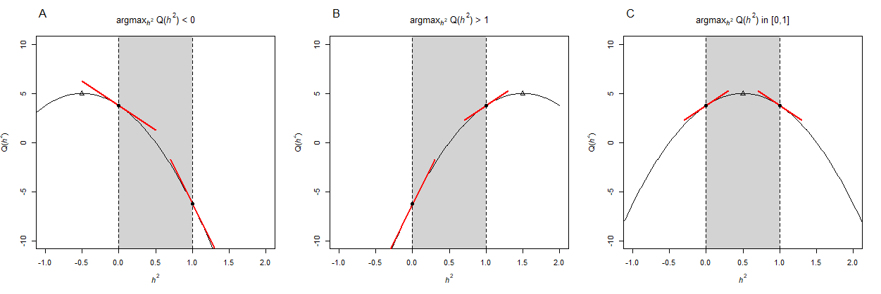
Estimation of the parameters
4. Heritability Estimation and Genetic Association Study on the Binary Trait
Notations and the disease model
Estimation of the parameters using the EM algorithm
Conditional expected score test
Illustration of KKT condition using a toy example

Slide 29
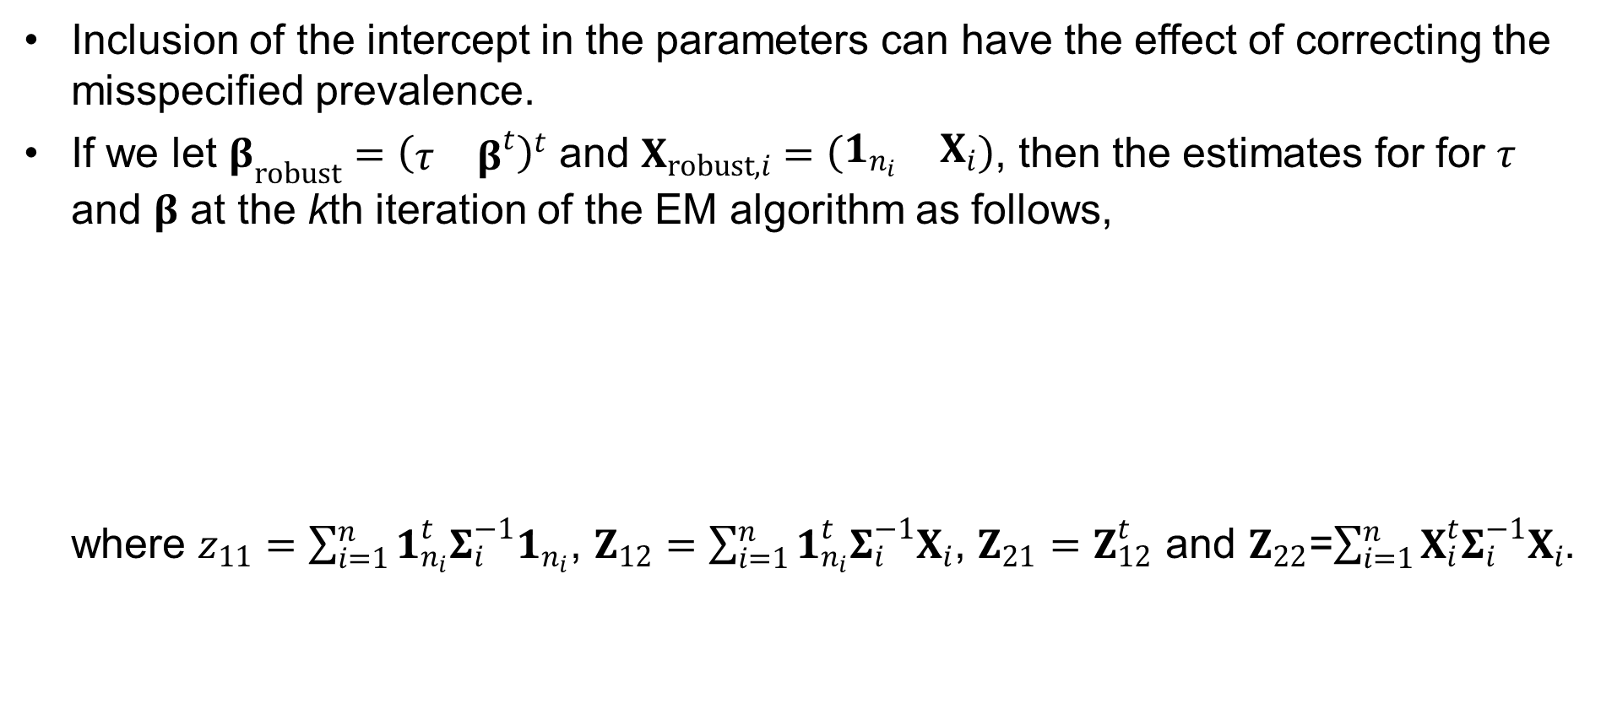
Robust Estimator to the Misspecified q
4. Heritability Estimation and Genetic Association Study on the Binary Trait
Notations and the disease model
Estimation of the parameters using the EM algorithm
Conditional expected score test
Inclusion of the intercept in the parameters can have the effect of correcting the misspecified prevalence.
If we let $β_{robust}={\left(\begin{matrix}τ & β^{t}\end{matrix}\right)}^{t}$ and $X_{robust,i}=\left(\begin{matrix}1_{n_{i}} & X_{i}\end{matrix}\right)$, then the estimates for for $τ$ and $β$ at the kth iteration of the EM algorithm as follows, where $z_{11}=\sum_{i=1}^{n}{1_{n_{i}}^{t}Σ_{i}^{−1}1_{n_{i}}}$, $Z_{12}=\sum_{i=1}^{n}{1_{n_{i}}^{t}Σ_{i}^{−1}X_{i}}$, $Z_{21}=Z_{12}^{t}$ and $Z_{22}$=$\sum_{i=1}^{n}{X_{i}^{t}Σ_{i}^{−1}X_{i}}$.

Slide 30
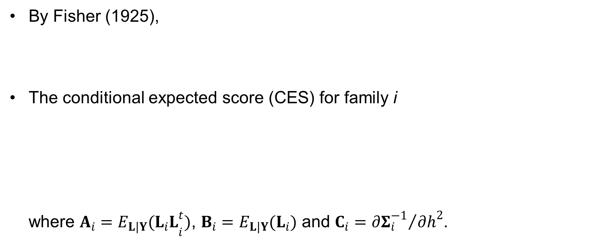
Conditional Expected Score Test (CEST)
4. Heritability Estimation and Genetic Association Study on the Binary Trait
Notations and the disease model
Estimation of the parameters using the EM algorithm
Conditional expected score test
By Fisher (1925),
The conditional expected score (CES) for family i where $A_{i}={E_{L|Y}(L_{i}L}_{i}^{t})$, $B_{i}=E_{L|Y}(L_{i})$ and $C_{i}={∂Σ_{i}^{−1}}/{∂h^{2}}$.

Slide 31
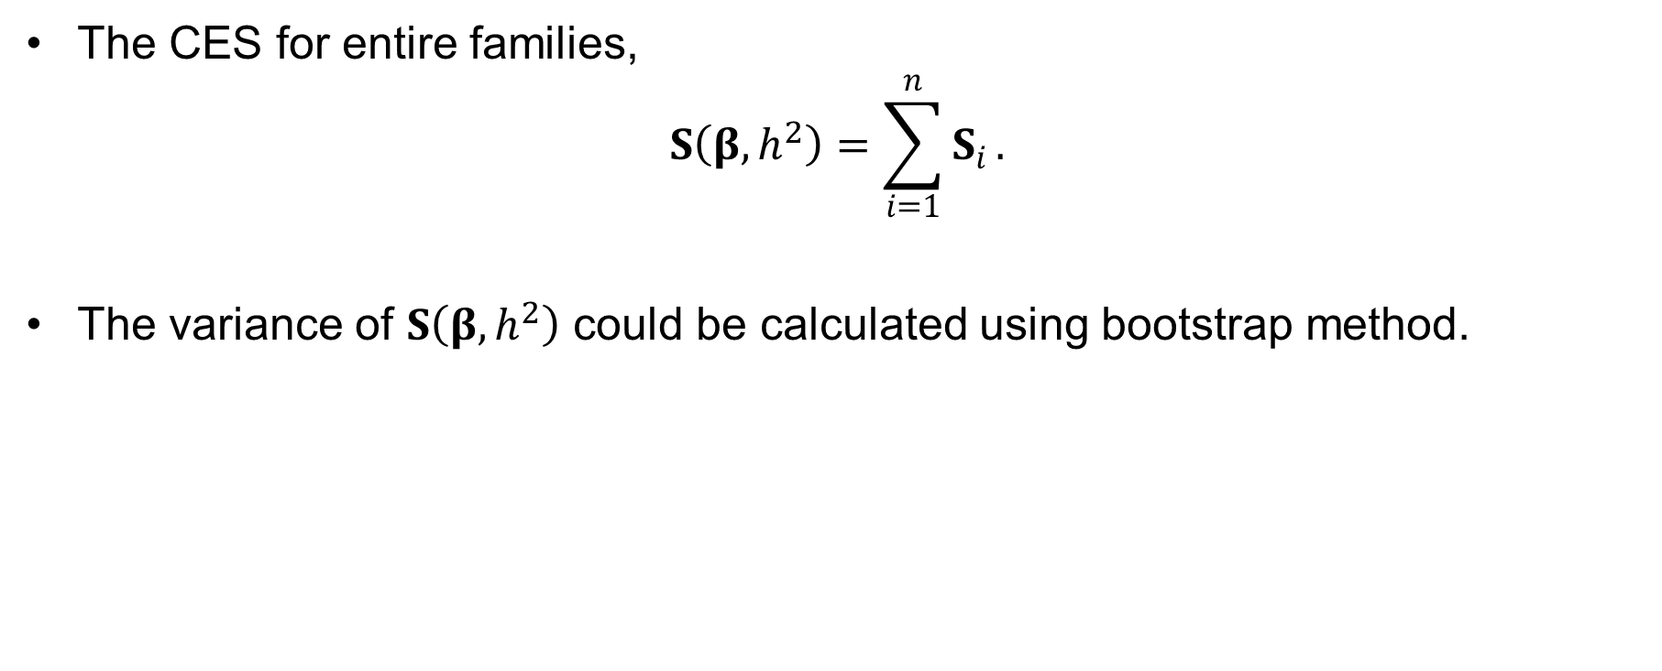
Conditional Expected Score Test (CEST)
4. Heritability Estimation and Genetic Association Study on the Binary Trait
Notations and the disease model
Estimation of the parameters using the EM algorithm
Conditional expected score test
The CES for entire families,
$$S\left(β,h^{2}\right)=\sum_{i=1}^{n}{S_{i}}.$$
The variance of $S\left(β,h^{2}\right)$ could be calculated using bootstrap method.

Slide 32
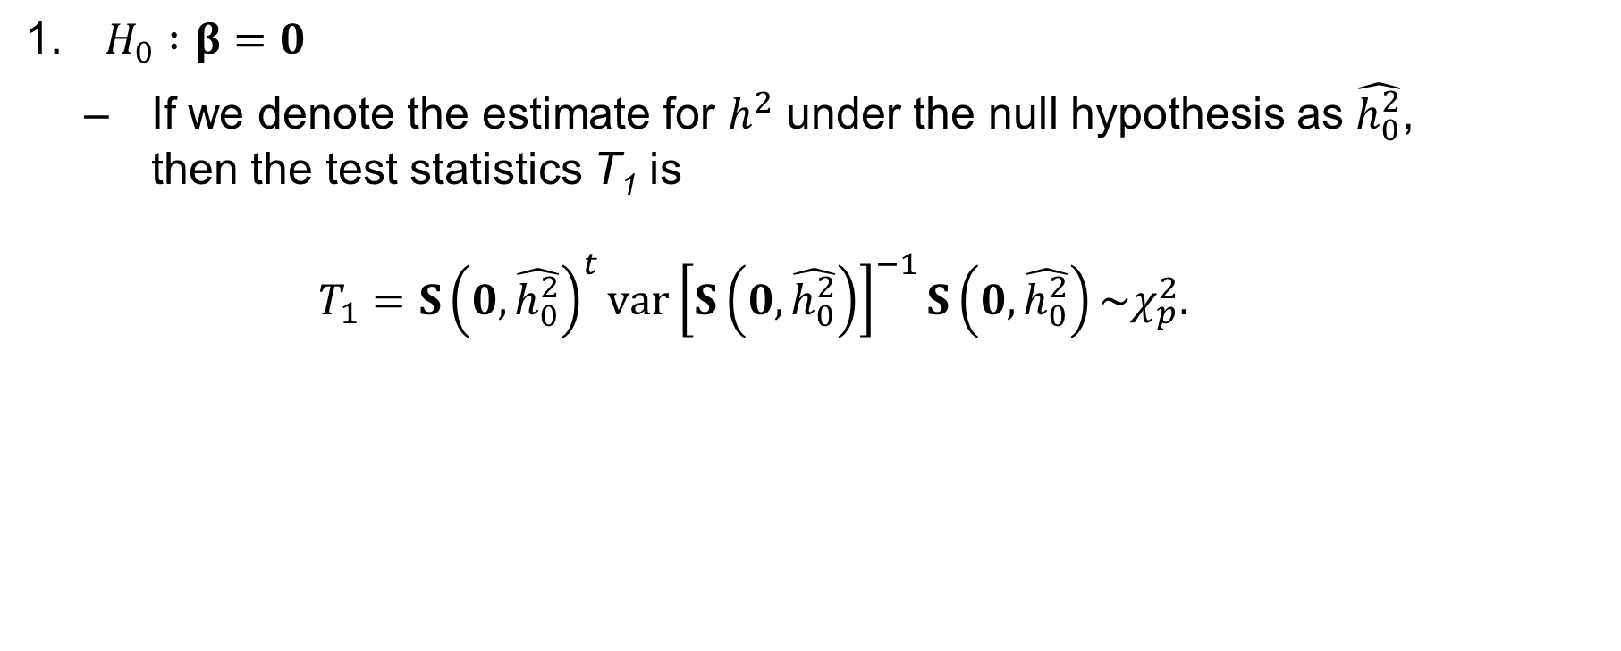
Conditional Expected Score Test (CEST)
4. Heritability Estimation and Genetic Association Study on the Binary Trait
Notations and the disease model
Estimation of the parameters using the EM algorithm
Conditional expected score test
$H_{0} :β=0$
If we denote the estimate for $h^{2}$ under the null hypothesis as $\hat{h_{0}^{2}}$, then the test statistics T₁ is $T_{1}=S{\left(0,\hat{h_{0}^{2}}\right)}^{t}var{\left[S\left(0,\hat{h_{0}^{2}}\right)\right]}^{−1}S\left(0,\hat{h_{0}^{2}}\right)\sim χ_{p}^{2}.$

Slide 33
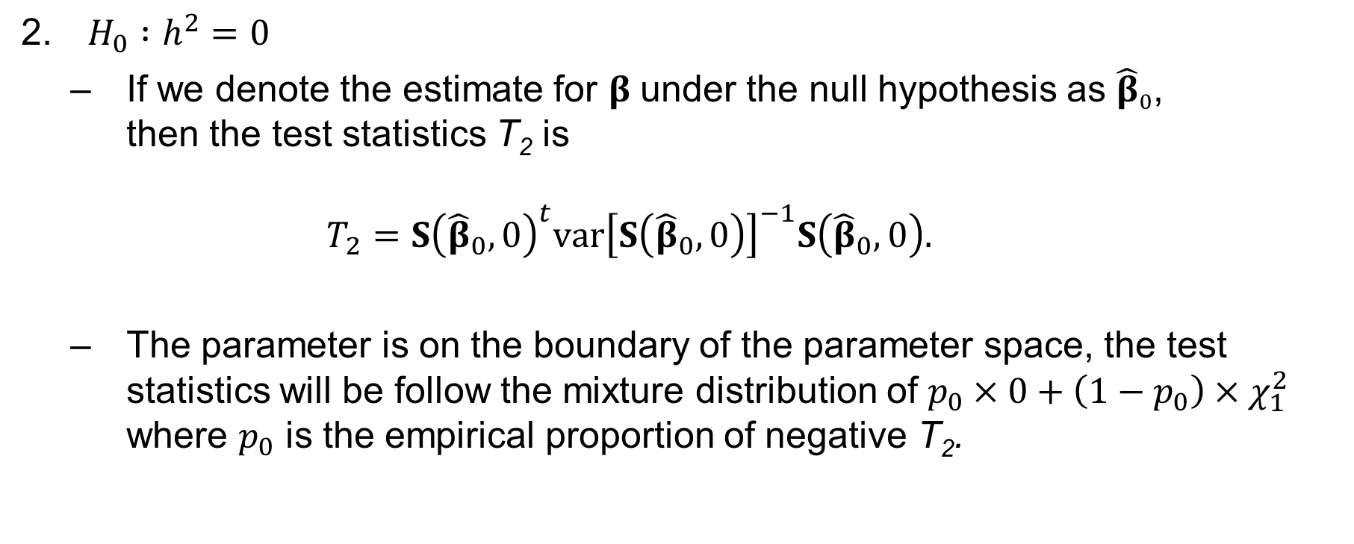
Conditional Expected Score Test (CEST)
4. Heritability Estimation and Genetic Association Study on the Binary Trait
Notations and the disease model
Estimation of the parameters using the EM algorithm
Conditional expected score test
$H_{0} :h^{2}=0$
If we denote the estimate for $β$ under the null hypothesis as ${\hat{β}}_{0}$, then the test statistics T₂ is $T_{2}=S{\left({\hat{β}}_{0},0\right)}^{t}var{\left[S\left({\hat{β}}_{0},0\right)\right]}^{−1}S\left({\hat{β}}_{0},0\right).$
The parameter is on the boundary of the parameter space, the test statistics will be follow the mixture distribution of $p_{0}×0+\left(1−p_{0}\right)×χ_{1}^{2}$ where $p_{0}$ is the empirical proportion of negative T₂.

Slide 34
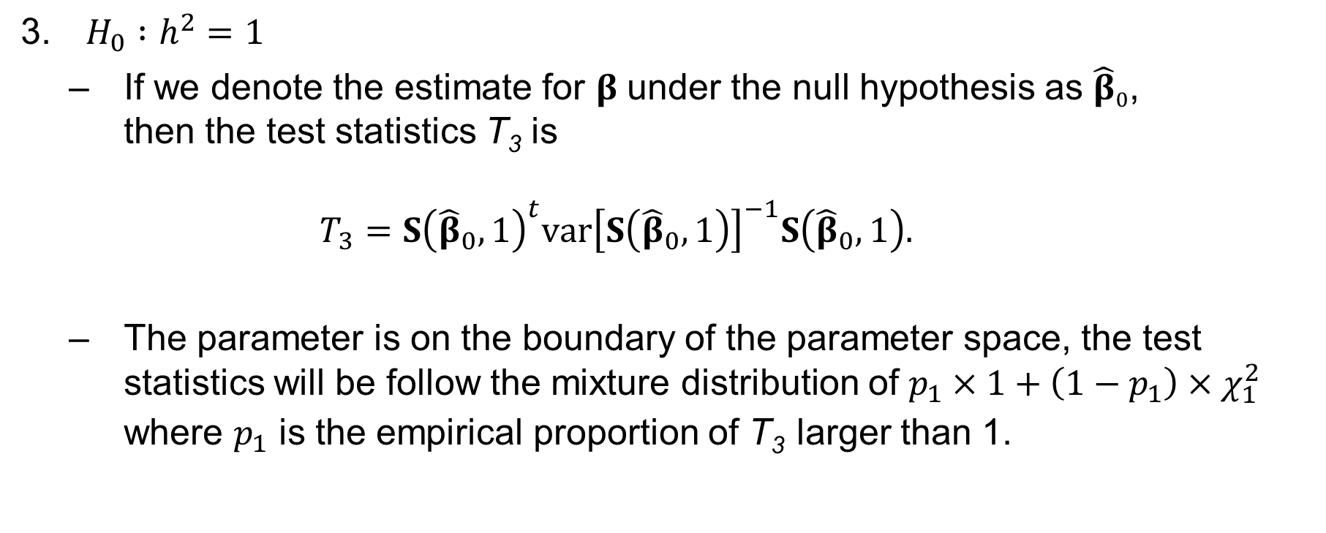
Conditional Expected Score Test (CEST)
4. Heritability Estimation and Genetic Association Study on the Binary Trait
Notations and the disease model
Estimation of the parameters using the EM algorithm
Conditional expected score test
$H_{0} :h^{2}=1$
If we denote the estimate for $β$ under the null hypothesis as ${\hat{β}}_{0}$, then the test statistics T₃ is $T_{3}=S{\left({\hat{β}}_{0},1\right)}^{t}var{\left[S\left({\hat{β}}_{0},1\right)\right]}^{−1}S\left({\hat{β}}_{0},1\right).$
The parameter is on the boundary of the parameter space, the test statistics will be follow the mixture distribution of $p_{1}×1+\left(1−p_{1}\right)×χ_{1}^{2}$ where $p_{1}$ is the empirical proportion of T₃ larger than 1.

Slide 35
Simulation Settings
4. Heritability Estimation and Genetic Association Study on the Binary Trait
Simulation study
Application to GWAS of LAM
Application to heritability estimation of CRC
10,000 families with three, four, five and six members consisting of a parents and offsprings at the rates of 0.2, 0.3, 0.3 and 0.2 respectively.
One causal SNP with MAF of 0.2 & h_{a}² : 0.005
No environmental effect
h² : 0.2 and 0.4 & q : 0.1 and 0.2
300 replicates with randomly selected 500 families among 10,000 families

Slide 36
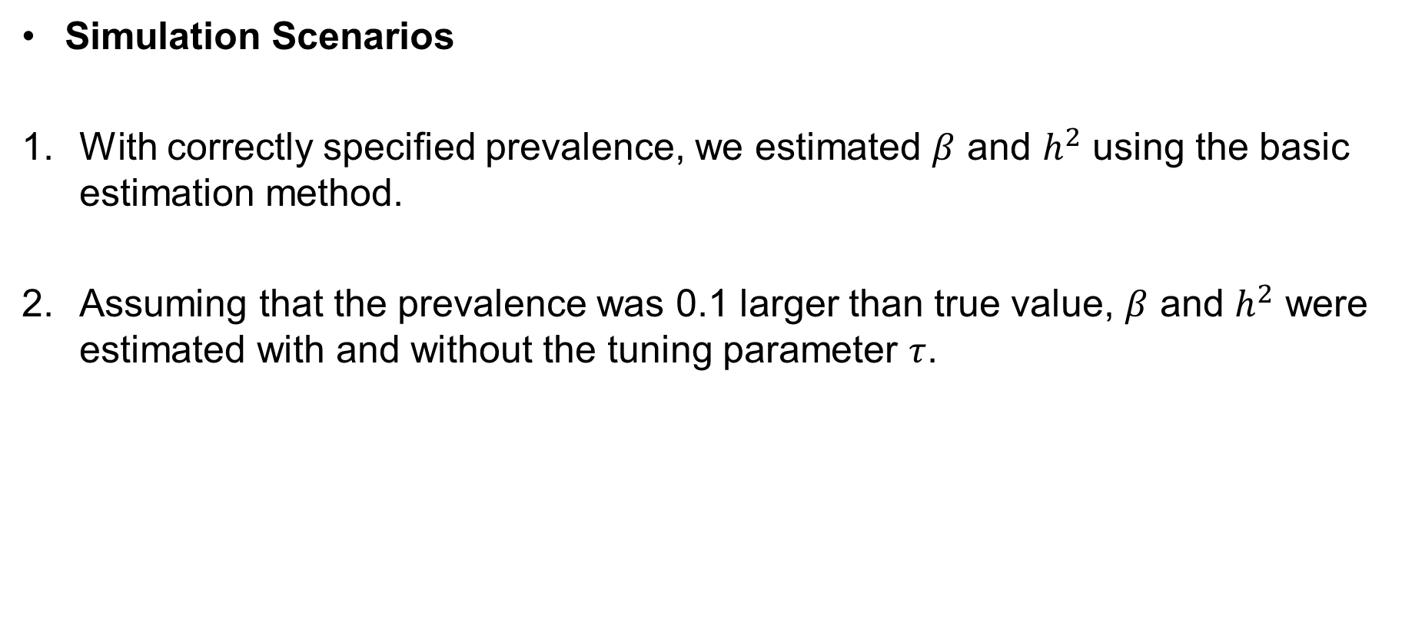
Simulation Settings
4. Heritability Estimation and Genetic Association Study on the Binary Trait
Simulation study
Application to GWAS of LAM
Application to heritability estimation of CRC
Simulation Scenarios
With correctly specified prevalence, we estimated $β$ and $h^{2}$ using the basic estimation method.
Assuming that the prevalence was 0.1 larger than true value, $β$ and $h^{2}$ were estimated with and without the tuning parameter $τ$.

Slide 37
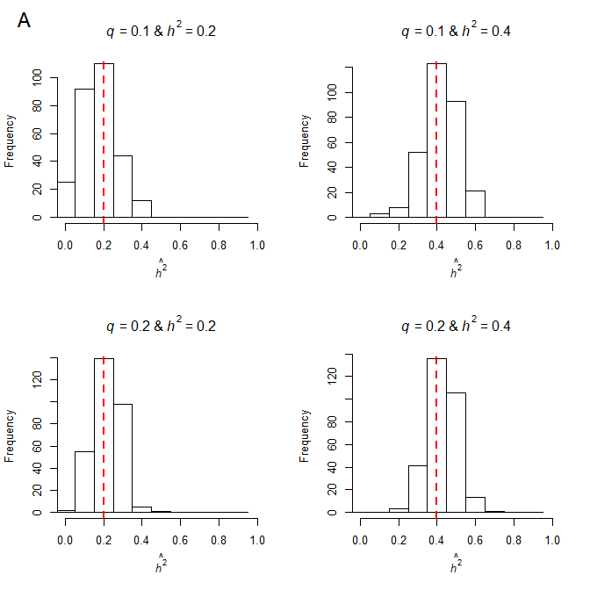
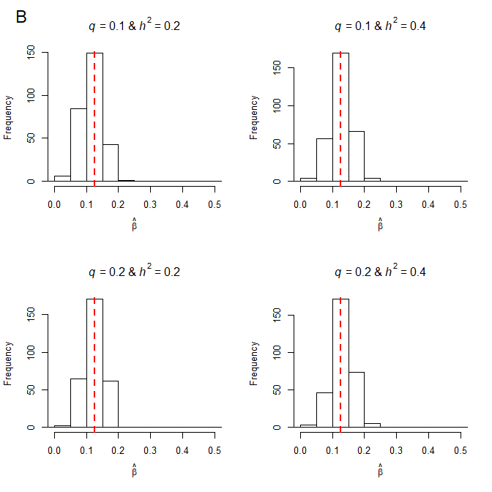
Simulation Results
4. Heritability Estimation and Genetic Association Study on the Binary Trait
Simulation study
Application to GWAS of LAM
Application to heritability estimation of CRC
With correctly specified prevalence

Slide 38
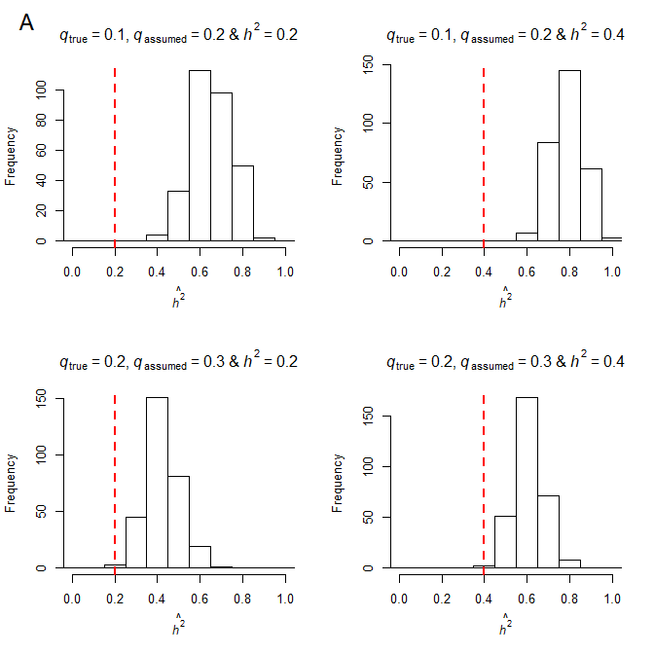
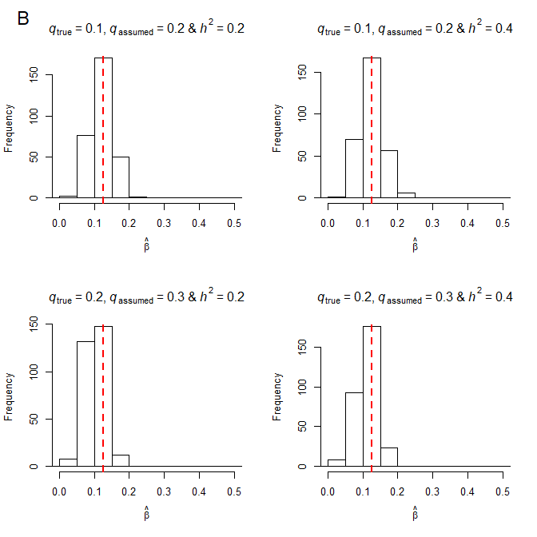
Simulation Results
4. Heritability Estimation and Genetic Association Study on the Binary Trait
Simulation study
Application to GWAS of LAM
Application to heritability estimation of CRC
With misspecified prevalences

Slide 39
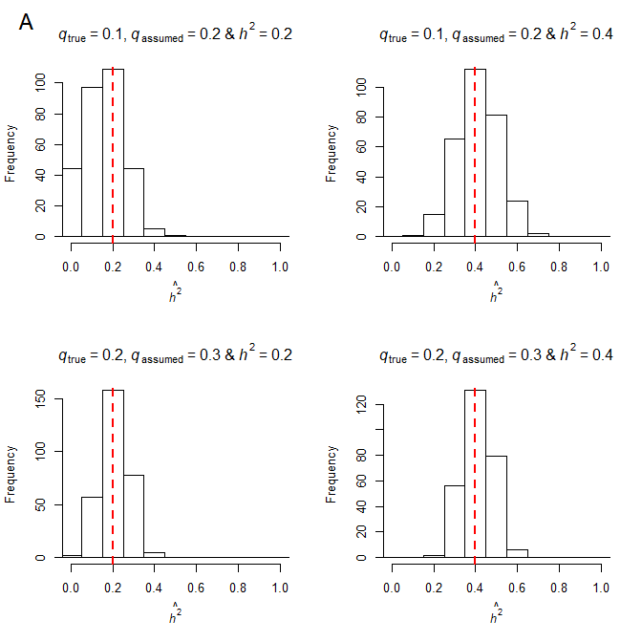
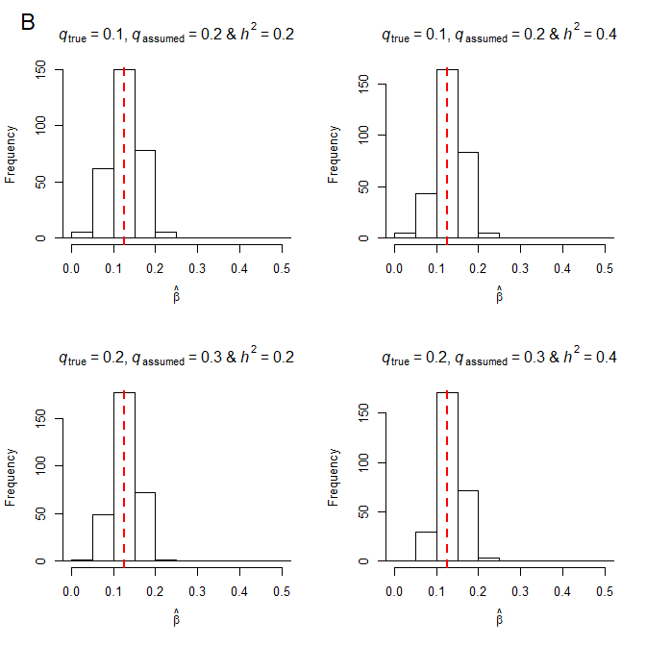
Simulation Results
4. Heritability Estimation and Genetic Association Study on the Binary Trait
Simulation study
Application to GWAS of LAM
Application to heritability estimation of CRC
With misspecified prevalences, including tuning parameter

Slide 40
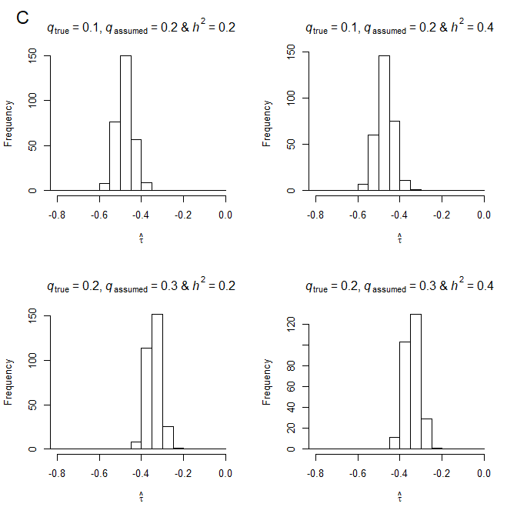
Simulation Results
4. Heritability Estimation and Genetic Association Study on the Binary Trait
Simulation study
Application to GWAS of LAM
Application to heritability estimation of CRC
With misspecified prevalences, including tuning parameter

Slide 41
Application to GWAS of LAM
4. Heritability Estimation and Genetic Association Study on the Binary Trait
Simulation study
Application to GWAS of LAM
Application to heritability estimation of CRC
Lymphangioleiomyomatosis (LAM) occurs in two settings:
in the disease tuberous sclerosis complex (TSC-LAM)
TSC-LAM occurs in women who have germline mutations in either the TSC1 or the TSC2 gene.
The TSC1 gene is located on chromosome 9q34
The TSC2 gene is located on chromosome 16p13.
in a sporadic form, in women who do not have TSC (sporadic LAM).
Prevalence of sporadic LAM is 1 per 2.5x10⁵

Slide 42
Application to GWAS of LAM
4. Heritability Estimation and Genetic Association Study on the Binary Trait
Simulation study
Application to GWAS of LAM
Application to heritability estimation of CRC
Hypothesis
DNA sequence variants outside of TSC2/TSC1 may be associated with susceptibility/risk for LAM disease development
Genome-wide association studies (GWAS) of sporadic LAM (S-LAM) are used to identify such genetic variants

Slide 43
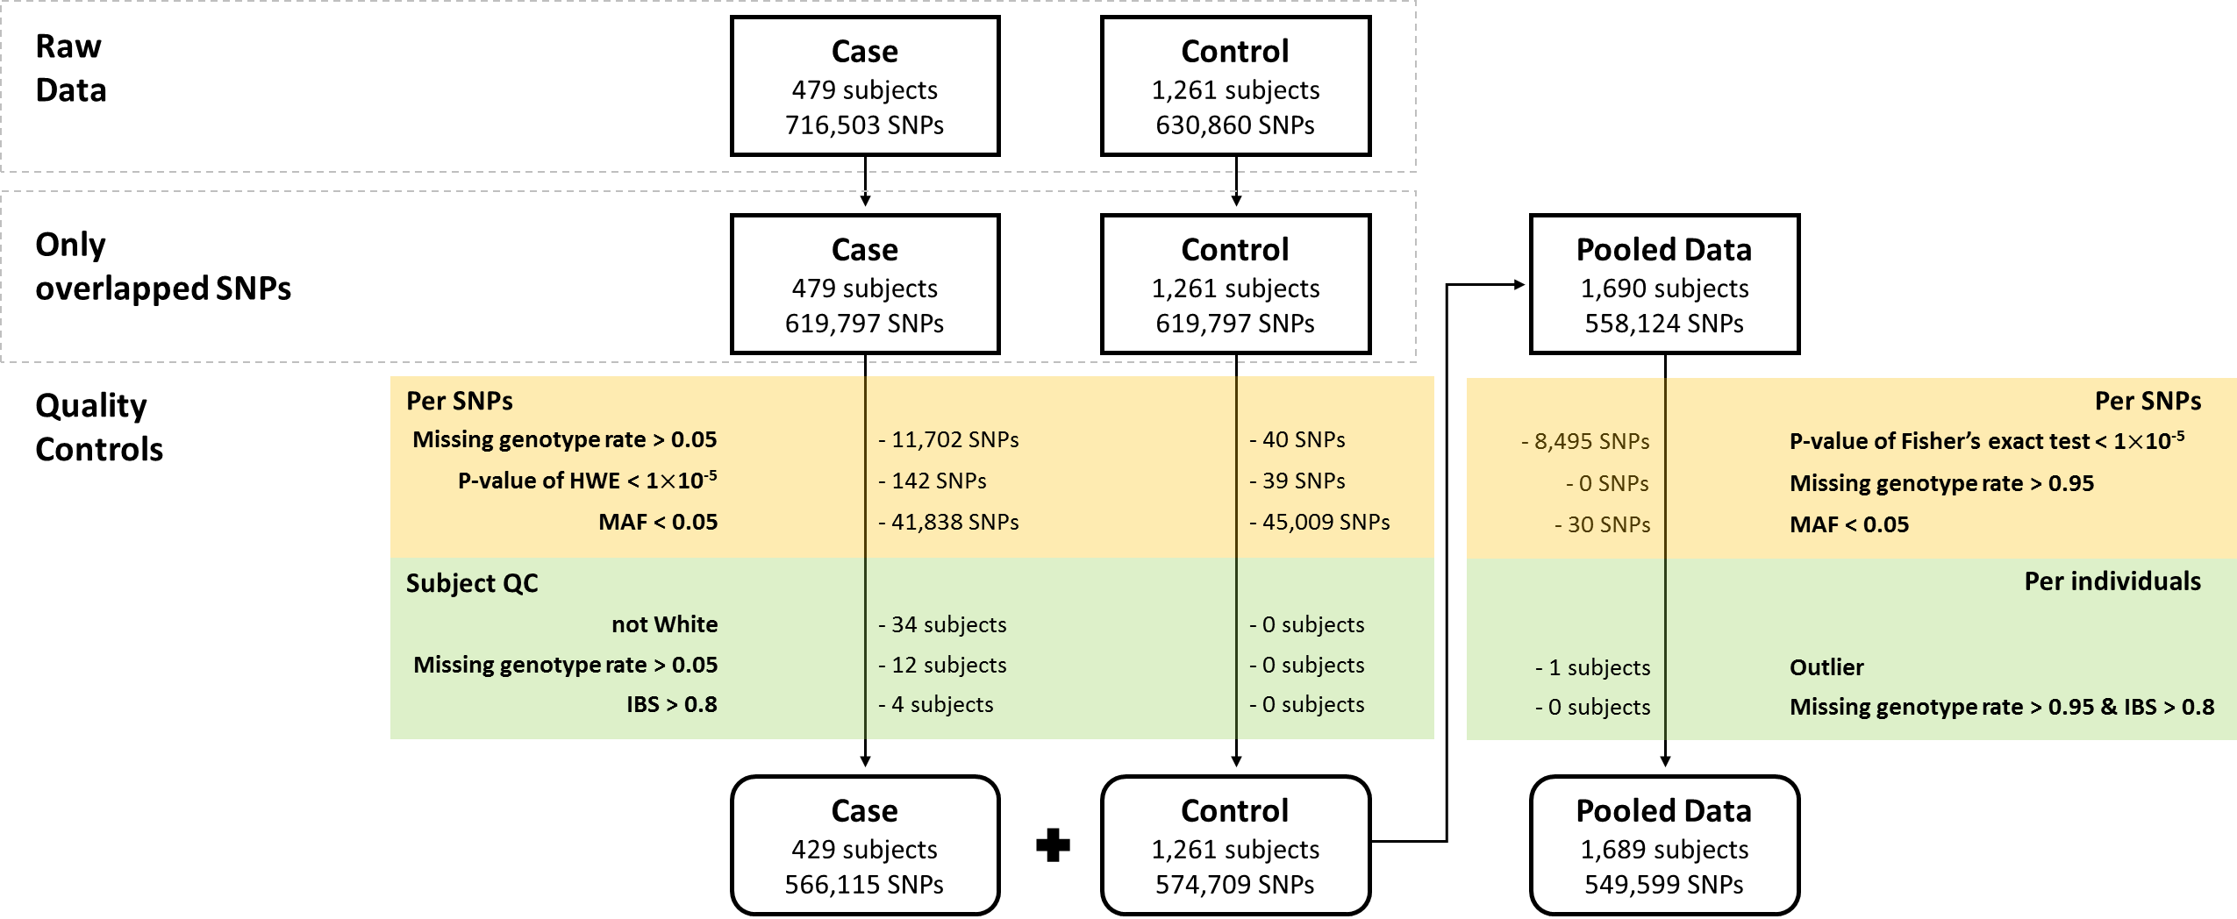
Application to GWAS of LAM
4. Heritability Estimation and Genetic Association Study on the Binary Trait
Simulation study
Application to GWAS of LAM
Application to heritability estimation of CRC
Data description and Quality control for discovery data

Slide 44
Application to GWAS of LAM
4. Heritability Estimation and Genetic Association Study on the Binary Trait
Simulation study
Application to GWAS of LAM
Application to heritability estimation of CRC
Study design
Logistic regression (LR)
Age, squared age and ten PC scores were included as covariates
Conditional logistic regression (CLR)
1:2 matched case-control design
Matching was based on age and top three PC scores

Slide 45
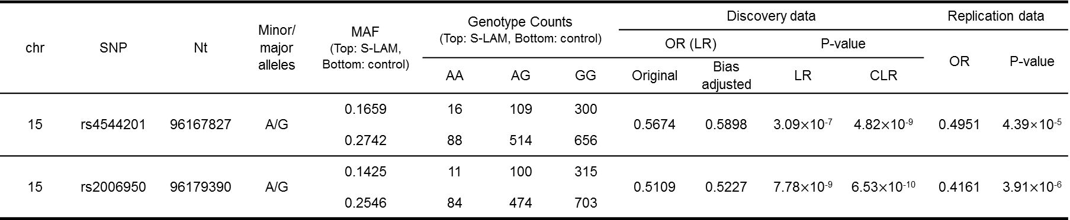
Application to GWAS of LAM
4. Heritability Estimation and Genetic Association Study on the Binary Trait
Simulation study
Application to GWAS of LAM
Application to heritability estimation of CRC
Results
chr | SNP | Nt | Minor/ major alleles | MAF (Top: S-LAM, Bottom: control) | Genotype Counts (Top: S-LAM, Bottom: control) |  |  | Discovery data |  |  |  | Replication data
 |  |  |  |  |  |  |  | OR (LR) |  | P-value |  | OR | P-value
 |  |  |  |  | AA | AG | GG | Original | Bias adjusted | LR | CLR
15 | rs4544201 | 96167827 | A/G | 0.1659 | 16 | 109 | 300 | 0.5674 | 0.5898 | 3.09$×$10⁻⁷ | 4.82$×$10⁻⁹ | 0.4951 | 4.39×10⁻⁵
 |  |  |  | 0.2742 | 88 | 514 | 656
15 | rs2006950 | 96179390 | A/G | 0.1425 | 11 | 100 | 315 | 0.5109 | 0.5227 | 7.78$×$10⁻⁹ | 6.53$×$10⁻¹⁰ | 0.4161 | 3.91$×$10⁻⁶
 |  |  |  | 0.2546 | 84 | 474 | 703

Slide 46
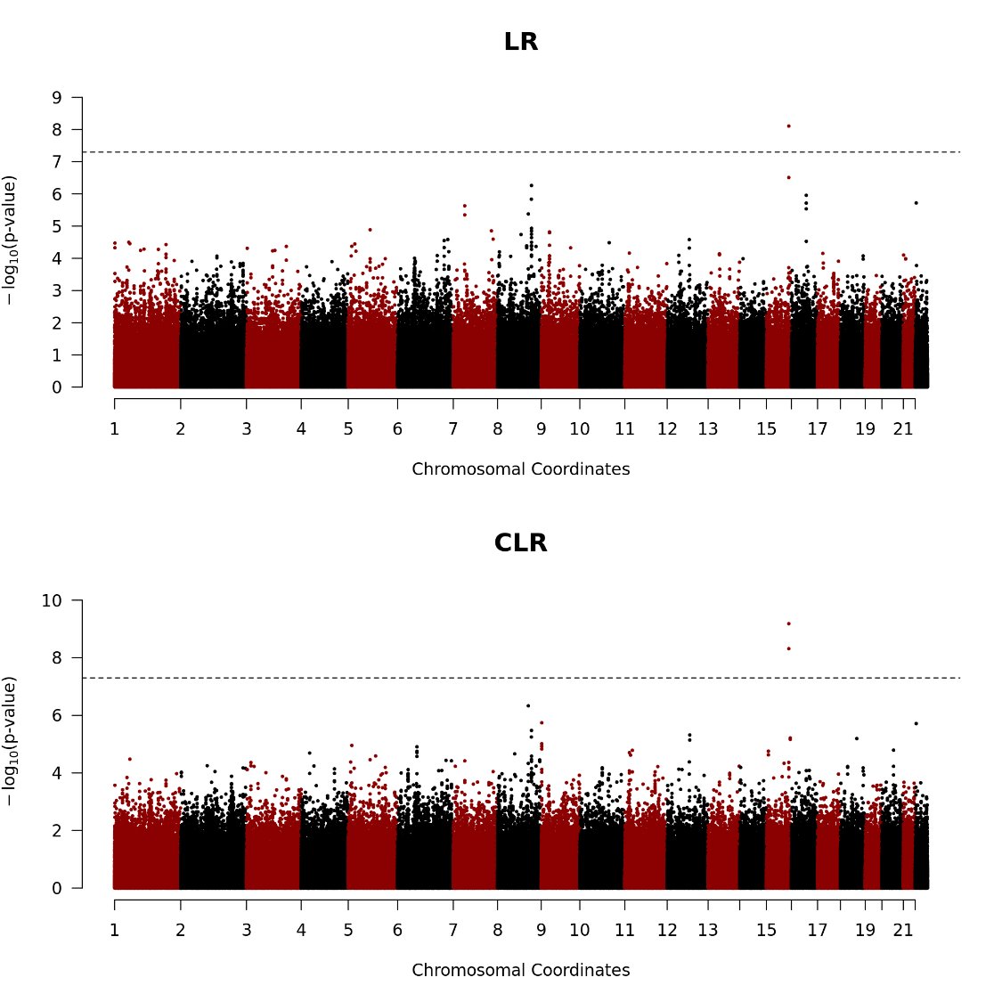
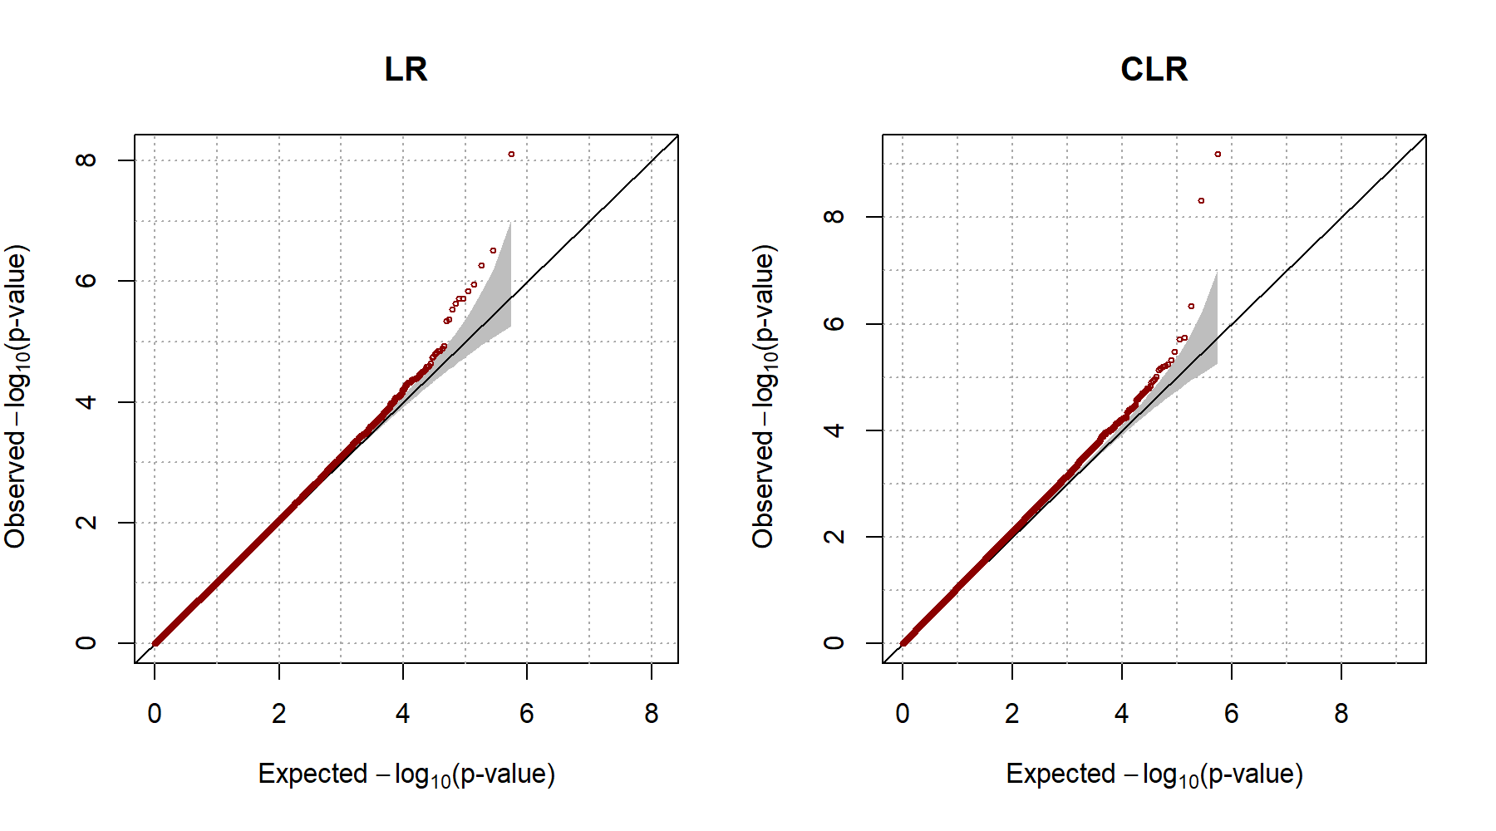
Application to GWAS of LAM
4. Heritability Estimation and Genetic Association Study on the Binary Trait
Simulation study
Application to GWAS of LAM
Application to heritability estimation of CRC
Results

Slide 47
Application to heritability estimation of CRC
4. Heritability Estimation and Genetic Association Study on the Binary Trait
Simulation study
Application to GWAS of LAM
Application to heritability estimation of CRC
Data description
The cross-sectional study of a prospective cohort database
Patients taken surgery for colorectal cancer (CRC) from 2003 to 2006 were collected from Seoul National University Hospital (SNUH) and Seoul National University Bundang Hospital (SNUBH)
Characteristic | 1,952 probands
Gender
Male | 1,153 (59.1 %)
Female | 799 (40.9 %)
Age at onset
Mean, Median (interquartile rage) | 61.7, 63 (55 - 70)
50 > | 229 (11.7 %)
50 ≤ | 1,723 (88.3 %)

Slide 48
Application to heritability estimation of CRC
4. Heritability Estimation and Genetic Association Study on the Binary Trait
Simulation study
Application to GWAS of LAM
Application to heritability estimation of CRC
Statistical Analysis
Family history (FH) of CRC for each proband was defined using first-degree of relatives (FDR) in two ways 1) the number of affected FDRs 2) the proportion of affected FDRs to all FDRs
Cox proportional hazards models were used to compute hazard ratio (HR) for CRC with FH.
HRs were adjusted using sex.

Slide 49
Application to heritability estimation of CRC
4. Heritability Estimation and Genetic Association Study on the Binary Trait
Simulation study
Application to GWAS of LAM
Application to heritability estimation of CRC
Relationship between family history of CRC and Incident CRC
Factor | No. of cases of CRC (n = 1,952) | Covariate adjusted Hazard ratio | 95% CI for Hazard ratio | P value
Family history of CRC
No | 1,766 | 1.00 (ref)
Yes | 186 | 1.1998 | (1.0306 - 1.3968) | 0.0188
No. of affected FDRs
0 (no FH) | 1,766 | 1.00 (ref)
1 FDR | 160 | 1.1240 | (1.0657 – 1.4756) | 0.0064
≥ 2 FDR | 26 | 0.9479 | (0.6433 – 1.3966) | 0.7865
Proportion of affected FDRs
[0, 0.125) | 1,843 | 1.00 (ref)
[0.125, 0.3) | 100 | 1.5949 | (1.3031 – 1.9519) | 5.933 x 10⁻⁶
[0.3,1] | 9 | 2.7498 | (1.4246 – 5.3078) | 0.0026

Slide 50
Conclusion and Discussion
4. Heritability Estimation and Genetic Association Study on the Binary Trait
Conclusion and Discussion
In this chapter, we proposed a method for estimating heritability and genetic/environmental effects on binary trait using liability threshold model
The results from the simulation studies showed that the proposed method provided robust estimators in spite of misspecification of the prevalence
However, there are many scenarios to check to evaluate the analytical flexibility such as when irrelevant covariates were included, a lot of nuclear families are included, and so on.

Slide 51
Conclusion and Discussion
4. Heritability Estimation and Genetic Association Study on the Binary Trait
Conclusion and Discussion
Further analyses
Evaluate robustness of the estimator for various situations
Compare the estimates to the existing methods
Consider the common shared correlation between family members
Evaluate statistical validity of CEST and compare existing method such as Logistic regression, MQLS, GLMM
Extend the proposed method to GWAS with the independent subjects via genetic relationship matrix

Slide 52
PLAN

Slide 53
Plan
July | August | September | October
Perform simulation studies for various scenario which can make bias of the proposed method and improve it Compare to the existing method | Implement CEST Compare the results from CEST to the existing method | Apply the proposed method to the real data (LAM, CRC) | Finish the manuscript

Slide 54
Thank you

